Slide 1
Data Science Workshop
Guy Azov
Brian Gordon
Shachar Banayan
Tomer Moinian

Slide 2
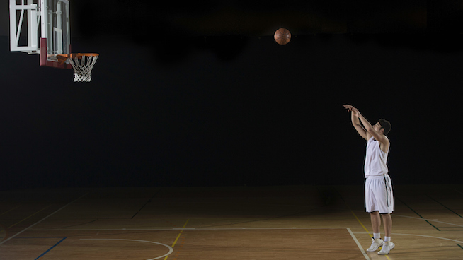
Project Goals
NBA Free Throws Prediction
Main Target: Try to predict whether a player will score a certain free throw (online prediction).
Secondary Target: Predict the players success percentage for the current season based on his past performance and give the coach an insight about the player (offline prediction).

Slide 3
Our Data
We chose a Kaggle free throws database and added a web scrapper for more players stats.
Our database includes:
617,786 NBA free-throws with 19 variables:
end_result
game
game_id
period
play
player
Position
FG%
3P%
FT%
Height
Weight
ShootingHand
draftRank
playoffs
score
season
shot_made
time

Slide 4
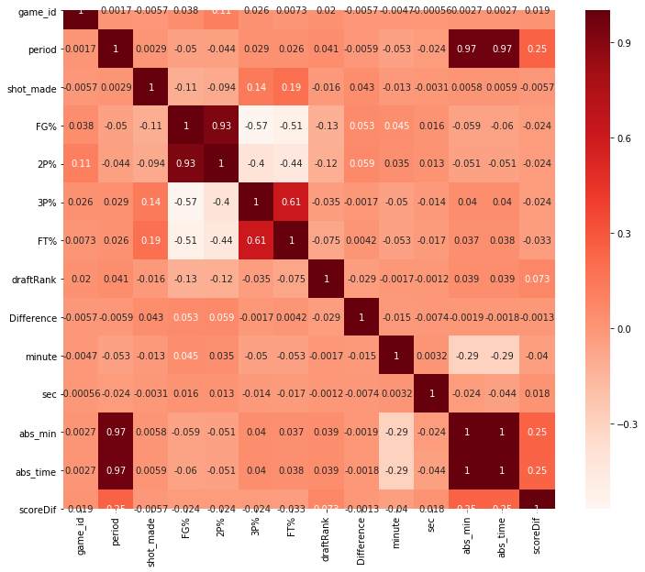
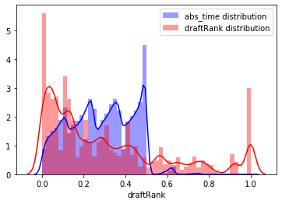
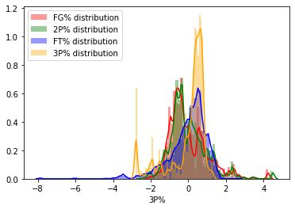
Data Understanding
We analyzed the dataset and checked the correlation
between our variables.
We chose the relevant columns for our prediction problem
We modified our data and manipulated it so it fit into machine learning model
manipulating the data using minmax scalar and standard scalar
Finding correlations

Slide 5
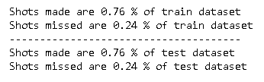
train-test split
Our data is unbalanced, 76% of the throws with shot made and 24% with shot missed
We split our data to train and test randomly and made sure we keep this ratio in the train and test groups:

Slide 6
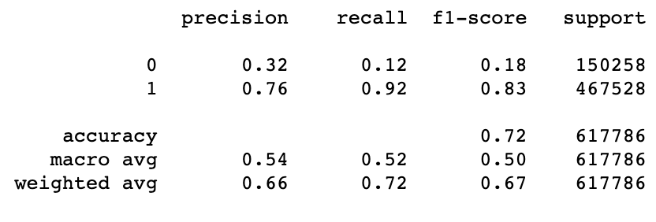
Baseline Model
Model without learning
Prediction based only on FT%
Threshold classification, FT% > 0.5 predicted as shot made, else missed.
Performance:

Slide 7
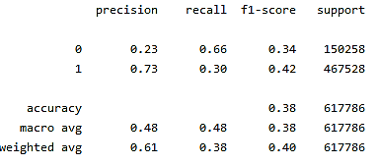
Another Baseline Model
As suggested by prof. Deuch, we tried a random model which toss a coin with the player’s ‘FT%’ score as it’s probability

Slide 8
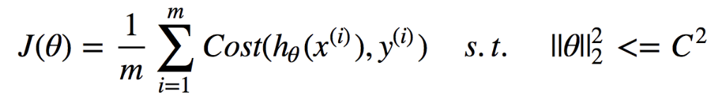
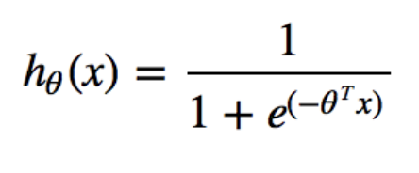
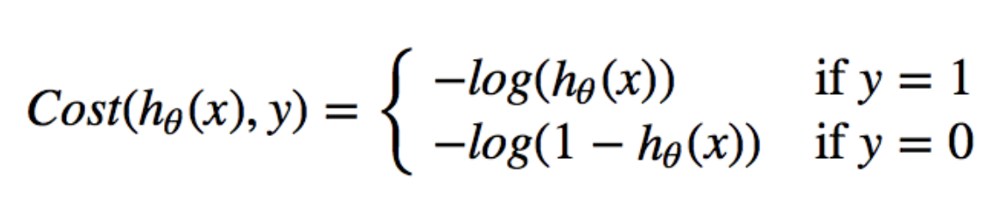
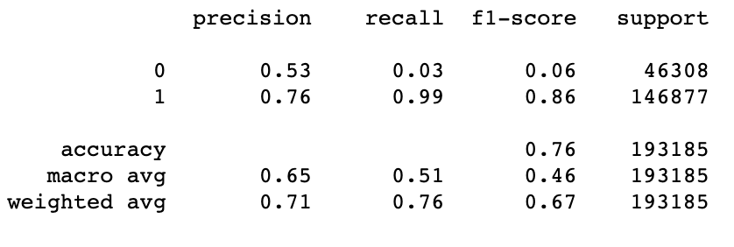
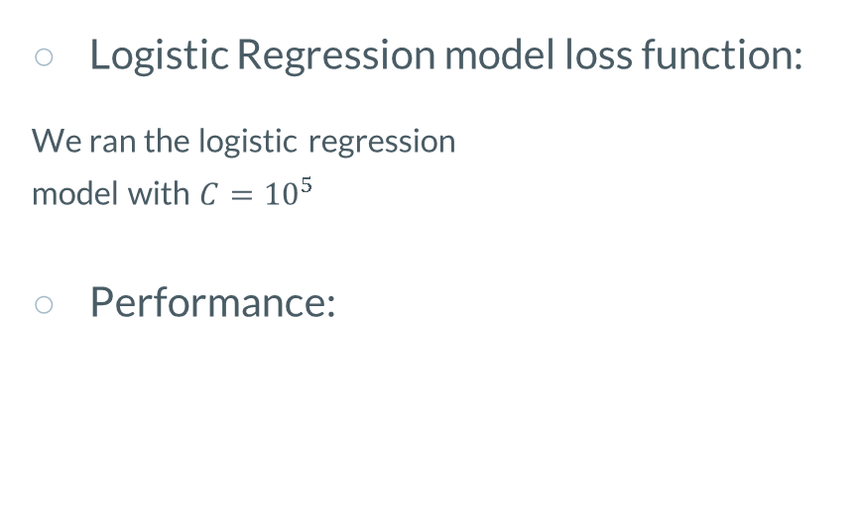
Log-Regression Model
Logistic Regression model loss function:
We ran the logistic regression
model with $C={10}^{5}$
Performance:

Slide 9
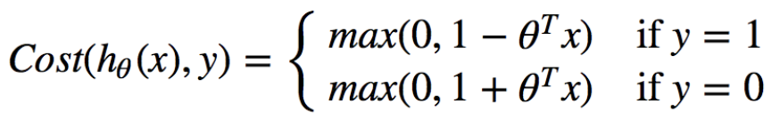
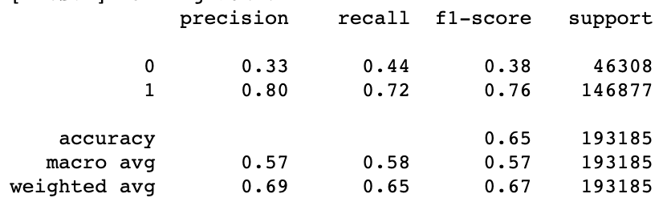
Linear SVM Model
Linear SVM model loss function:
We ran the SVM model with
kernel = ‘linear’
class weight = ‘balanced’
verbose = True
C = 1
Performance:
Notes:
השתמשתי במה שהיה לנו קודם, זה עם החלוקה הקודמת לאימון ומבחן

Slide 10
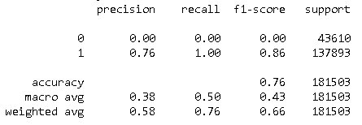
Neural Net - binary_crossentropy LOSS
Neural Net - binary_crossentropy LOSS:
We used ……
Notes:
להוסיף את הפרמטרים שהשתמשנו בהם ברשת, מבנה הרשת

Slide 11
Unbalanced database problem
We can see that because our dataset is not balanced, our models tend to predict '1' (shot made) most of the time, we have a problem.
If we look at the recall parameter on label '0' (shot missed) we can see that we receive really bad performance on this metric.
We will try to attack this problem with some different methods
Notes:
להוסיף את הפרמטרים שהשתמשנו בהם ברשת, מבנה הרשת

Slide 12
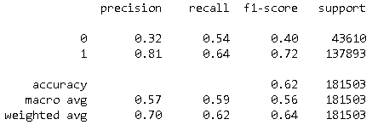
Trying to balance the database
Neural Net - binary_crossentropy LOSS with Oversampling try:
We oversample the throws with shot missed so our train and test have equal amount of shot made and shot missed samples
We can see that this method helps us to achieve better recall metric on label '0', but we receive a -10% performance on accuracy.

Slide 13
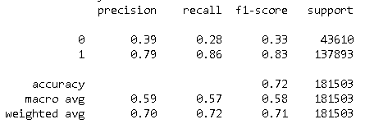
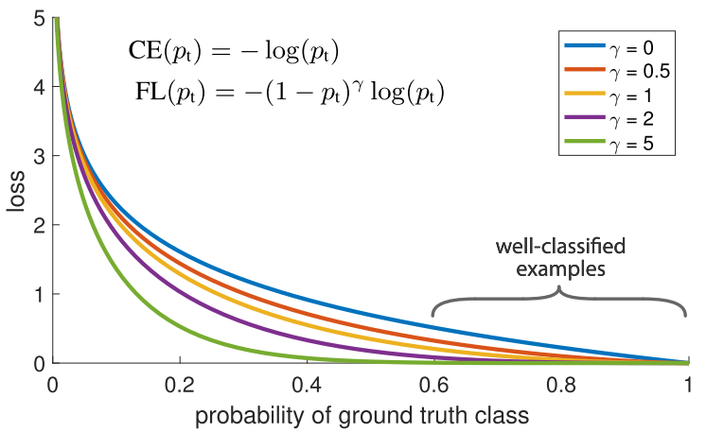
Trying to use FocalLOSS
Focal loss down-weights the well-classified examples, so used it to insure that we also achieve high accuracy on our minority class by giving them more relative weight during training.
we get an improvement on our label '0' recall , but our accuracy performance is still lower than the baseline model

Slide 14
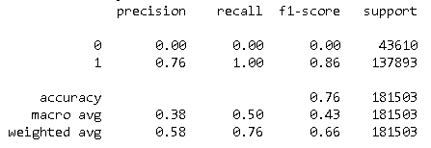
xgboost regressor model with Shap visualization
XGboost regressor model with Shap visualization :
Regularization: It penalizes more complex models through both LASSO (L1) and Ridge (L2) regularization to prevent overfitting.
Weighted Quantile Sketch: it employs the distributed weighted Quantile Sketch algorithm to effectively find the optimal split points among weighted datasets.
Cross-validation: comes with built-in cross-validation method.

Slide 15
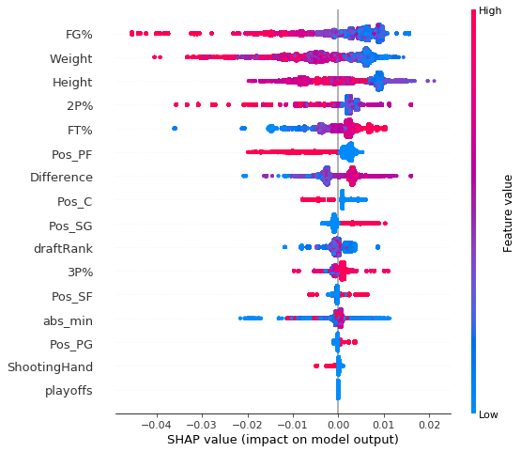
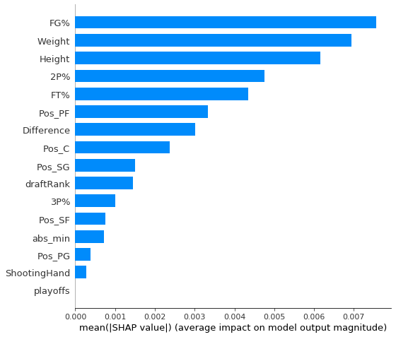
xgboost regressor model with Shap visualization
XGboost regressor model :
Notes:
יש פה בעיה עם התוצאות שלנו!

Slide 16
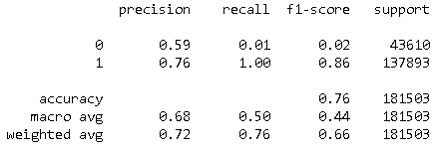
xgboost classifier model with Shap visualization
XGboost classifier model with Shap visualization :
We tried also the classifier of Xgboost with the parameters : {objective = reg:linear, colsample_bytree = 0.3, learning_rate = 0.1, max_depth = 5, alpha = 10}
Notes:
יש פה בעיה עם התוצאות שלנו!

Slide 17
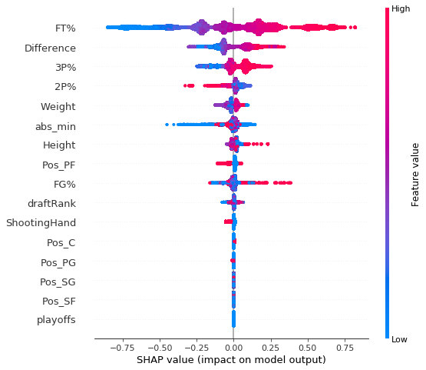
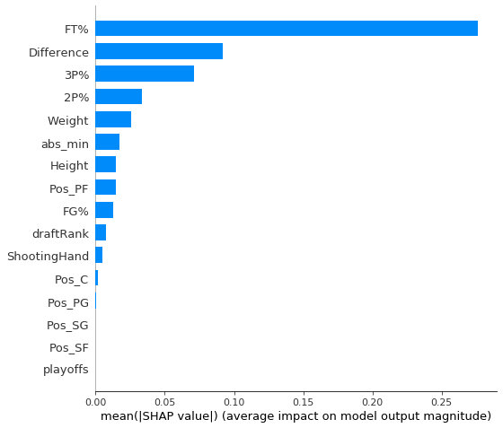
xgboost classifier model with Shap visualization
XGboost classifier model with Shap visualization :
Notes:
יש פה בעיה עם התוצאות שלנו!

Slide 18
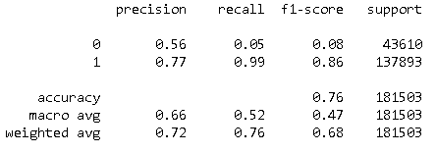
xgboost classifier model with FocalLoss
XGboost classifier model with FocalLoss:
We tried running the Xgboost classifier with focal loss
Notes:
יש פה בעיה עם התוצאות שלנו!

Slide 19
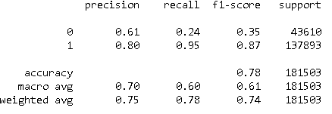
Random Forest Model
Random Forest Model:
We ran a random forest model with the parameters:
n_estimator = 16
Max_depth = 20
Random_state = 0

Slide 20
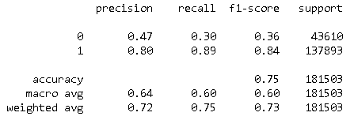
K-Nearset Neighbours Model
K-Nearset Neighbours Model:
With the parameters:
n_neighbors = 5
metric = ‘Minkowski’
p = 2

